Slide 1
Principles of two-photon microscopy
Joe Donovan

Slide 2
Problem: out of focus light

Slide 3
Problem: scattering
Selecting emitted light is difficult when scattered

Slide 4
What if we could confine the excitation process?
How? – the excitation light has to reach the focus

Slide 5
Excitation process
One photon
Two photon
Linear
emission ∝ excitation
Non-linear
emission ∝ excitation²

Slide 6
Nonlinearity

Slide 7
Spatial profiles

Slide 8
Absorption cross section
How likely is a photon to interact with a molecule?
1 photon cross section has units of cm² photon⁻¹
2P cross section has units of Goeppert-Mayer
1 GM = 10⁻⁵⁰ cm⁴ second photon⁻¹
2P cross sections are small!
Notes:
Not physical size

Slide 9
Math time!
$photons \left(per pulse per molecule\right)∝$
$$\frac{{fluorophore_crosssection ∗laser_pulse_energy}^{2} ∗ {NA}^{2}}{pulse_duration ∗ λ^{2}}$$
High NA is important for 2P
Short laser pulses critical
Ti-saph: 80 MHz rep rate, ~100 fs pulses
Notes:
Duty cycle under 1e-5
This isn’t considering the benefits of NA for collection
$${(\frac{1}{2ℏc})}^{2}$$

Slide 10
Brief laser intro
Laser gain medium
Mirror
Mirror

Slide 11
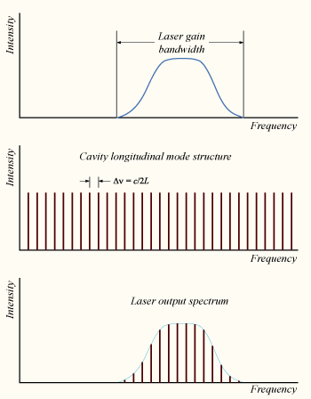
Laser cavity modes
Wikipedia
Notes:
Can introduce a relationship between their phases - modelocking

Slide 12
Laser modelocking
Encourage fixed phase relationship between modes
Single pulse traversing laser cavity
Achieved using saturable absorber, non-linear optical effects, or active modulation
Wikipedia

Slide 13
Ultrashort pulses

Slide 14
Refractive index varies with wavelength
Notes:
Around 20-50nm of spectral bandwidth

Slide 15
Ultrashort pulse dispersion
group velocity dispersion (GVD)

Slide 16
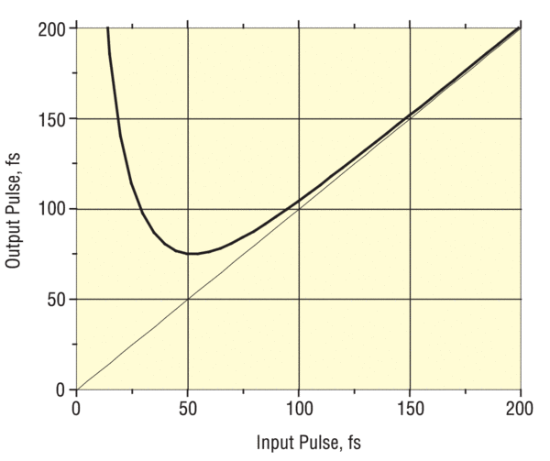
Dispersion - 20 mm of glass
Newport

Slide 17
Additional 2P benefits
Excitation wavelength ~twice as long (NIR)
NIR has less scattering and absorption
Imaging laser is invisible to live samples

Slide 18
Photon collection
Do we need a pinhole?
Nope!
Can use all collected light, even if scattered

Slide 19
White board time!
Derive 2P layout

