Slide 1
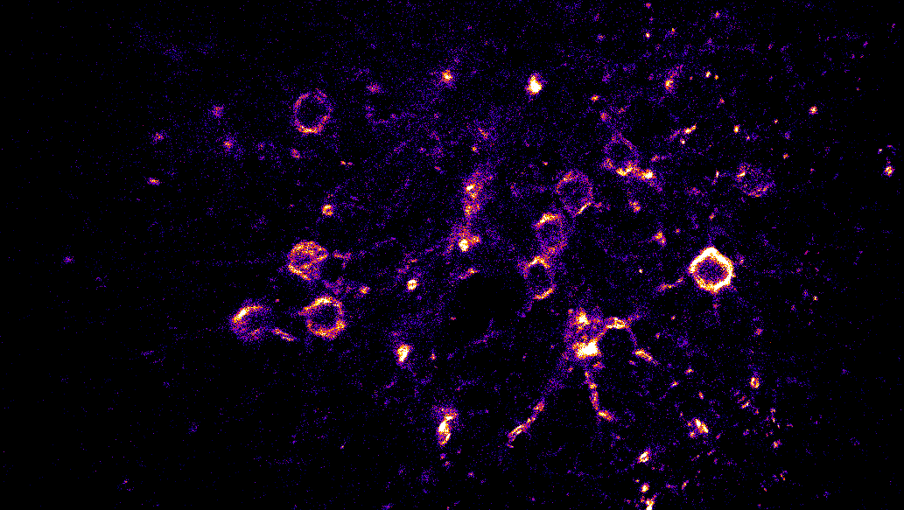
Imaging voltage signals in cortical layer 1 of awake mice
Ben Schuman
August 11, 2019
Cold Spring Harbor Laboratory, Imaging Structure and Function in the Nervous System

Slide 2
The goals and the questions:
Project #1 – Voltage imaging in awake head-fixed mice.
What does the raw signal looks like?
How does that signal change with depth, expression, etc…?
What are good and bad examples?
How is the data processed and visualized?
Can I really see spikes?
Project #2 – Calcium imaging in awake head-fixed mice.
No going to talk about this today.

Slide 3
Project #1: Voltage imaging in awake mice.
ASAP3 voltage imaging in awake head-fixed mouse
Newest version; two photon compatible voltage indicator; soma-targeted
Developed by Michael Lin’s lab; virally injected, sparse infection
Inverted signal, so spikes and depolarizations are decreased fluorescence
Imaged L1 cells (all interneurons) and L2/3 pyramidal cells; only discussing L1
L1 cell responses are particularly relevant to my work.
Deeper imaging includes more neuropil = worse SNR
Visual cortex during spontaneous activity and moving gratings; only discussing moving gratings
Utilized Stephane and Benjamin’s two-photon ultrafast local volume excitation (ULOVE) system
ULOVE utilizes AODs for imaging volumes very fast (kHz rates)
Random access imaging

Slide 4
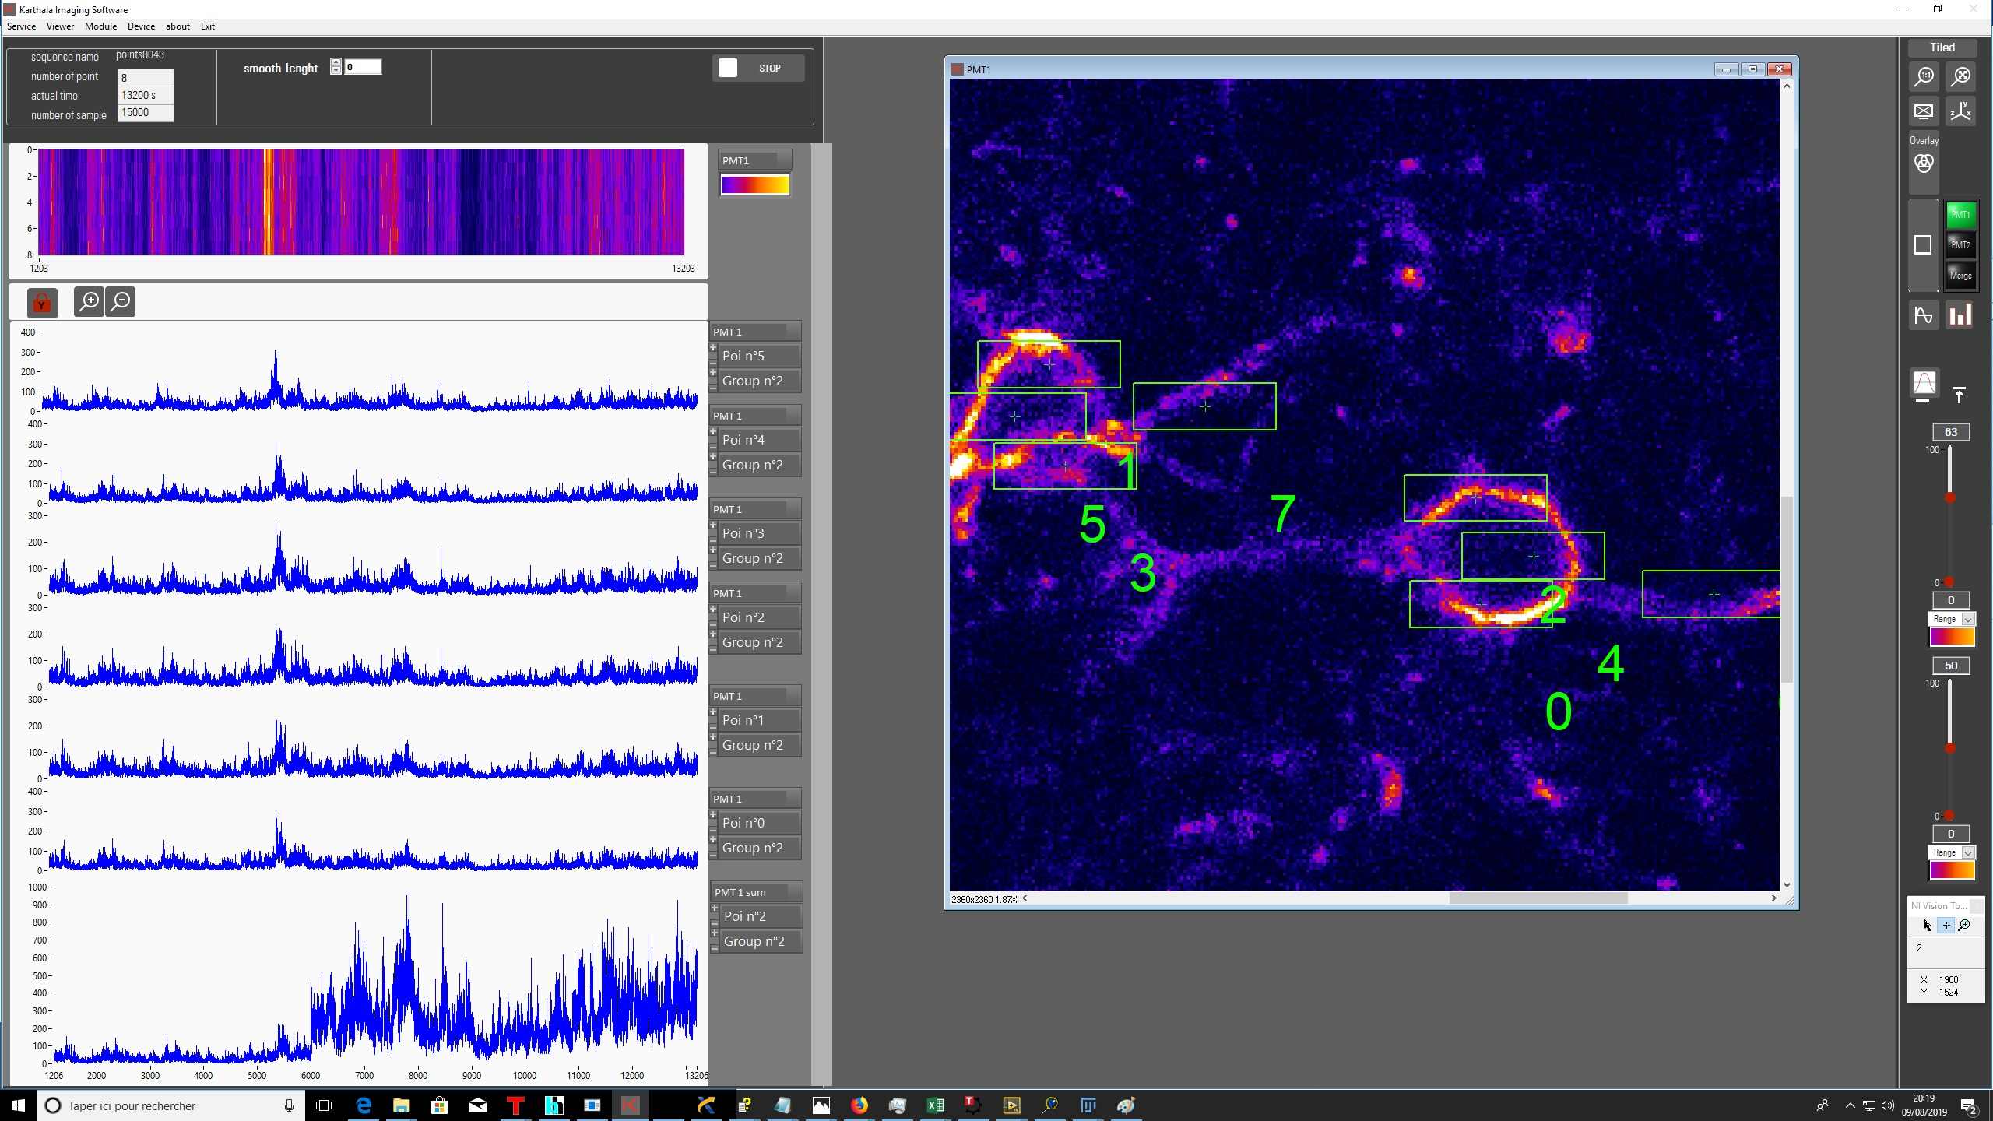

Slide 5
Do L1 interneurons have preferred stimuli?

Slide 7
Can we automatically extract spikes?
Extract data from software
Remove initial bleaching period
High pass filter the data
Error function
Determine a threshold for spiking
Find spike times
Use stimulus files to find stimulus times
Bin the spikes by stimulus period (ON or OFF)
Bin ON spikes by similar stimuli

Slide 8
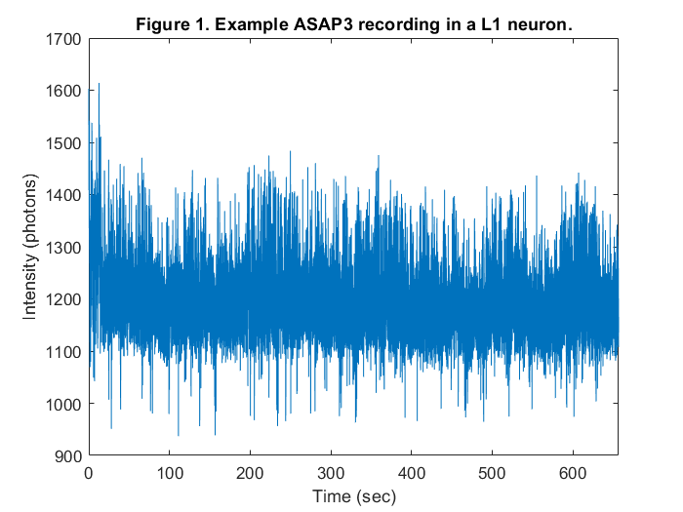
Hyperpolar.
Example L1 cell (~70μm deep)
Depolarization

Slide 9
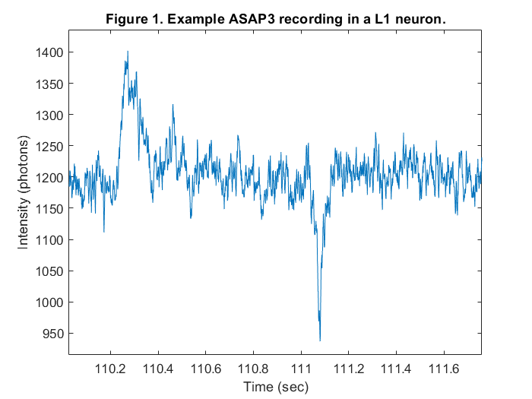
Hyperpolar.
Spike
Example L1 cell (~70μm deep)
Depolarization

Slide 10
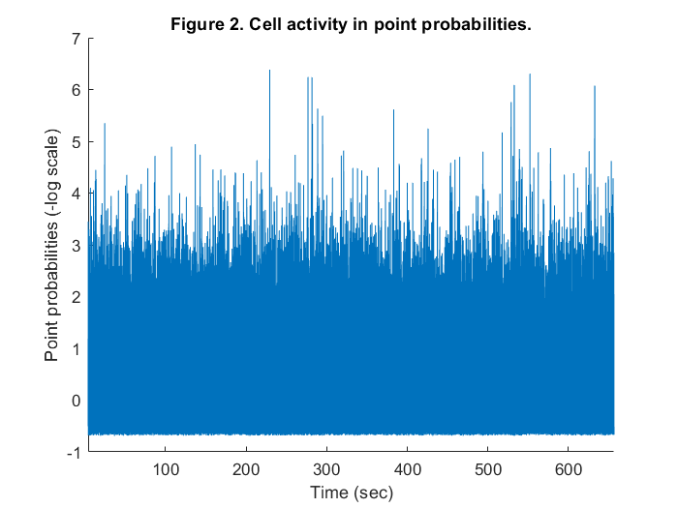
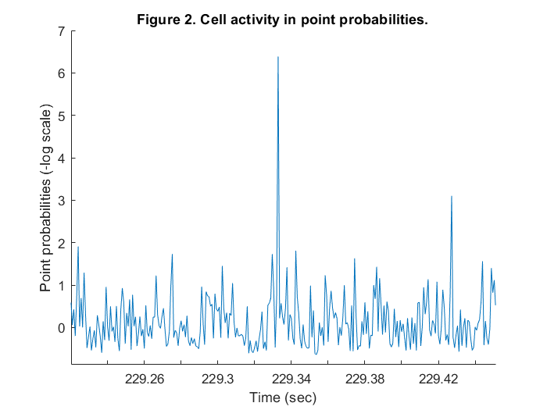
Cell activity in point probabilities
Spike

Slide 11
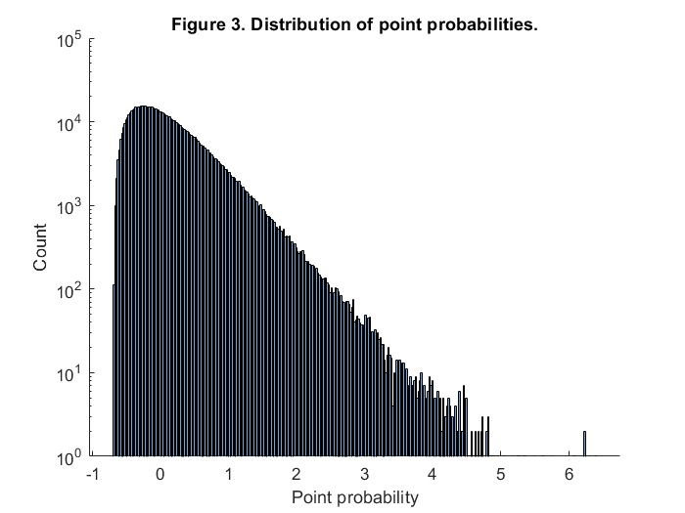
Threshold

Slide 12
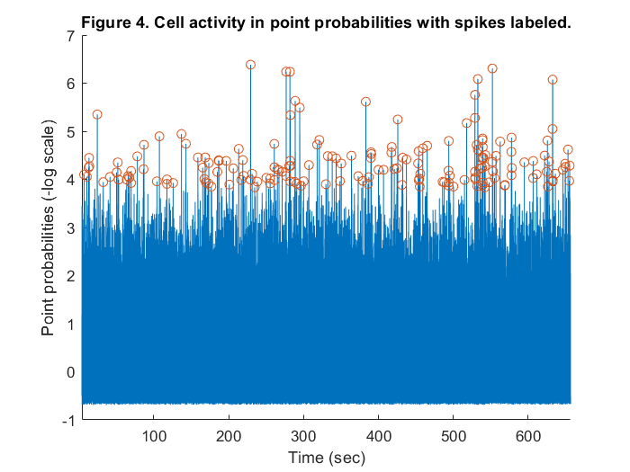

Slide 13
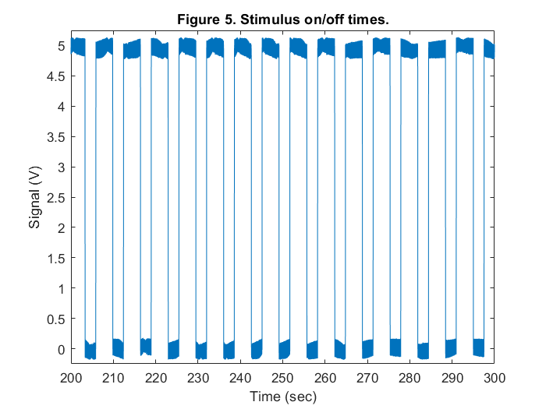
We know exactly when stimulus is delivered

Slide 14
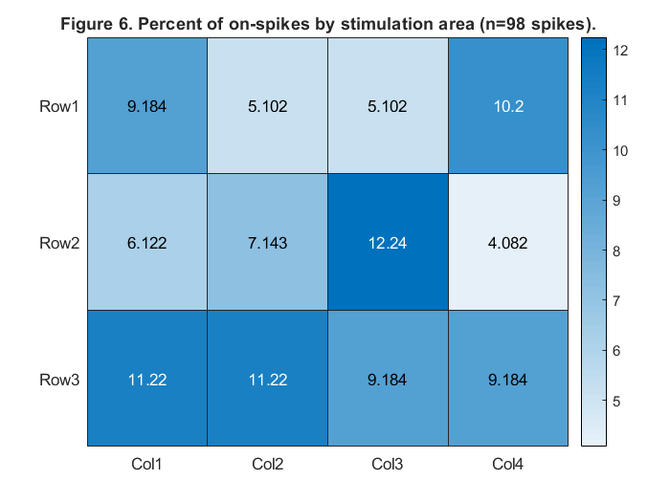

Slide 15
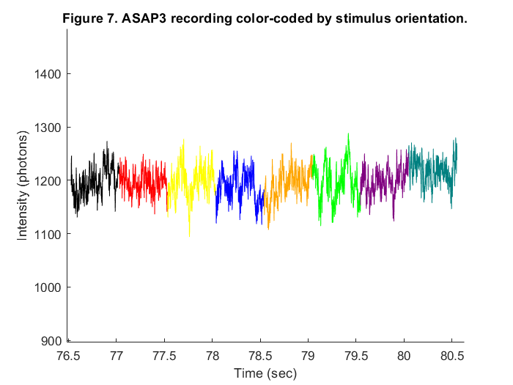
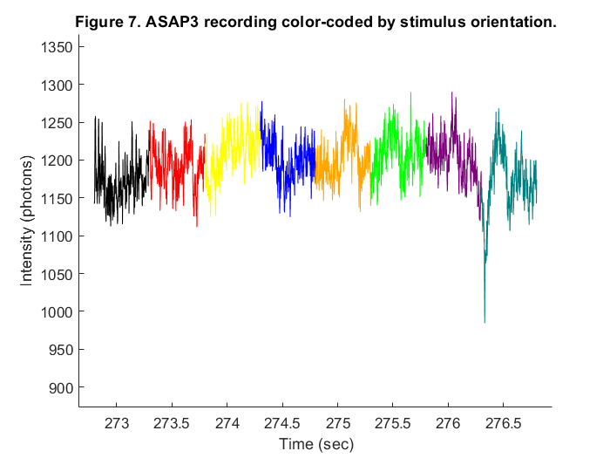
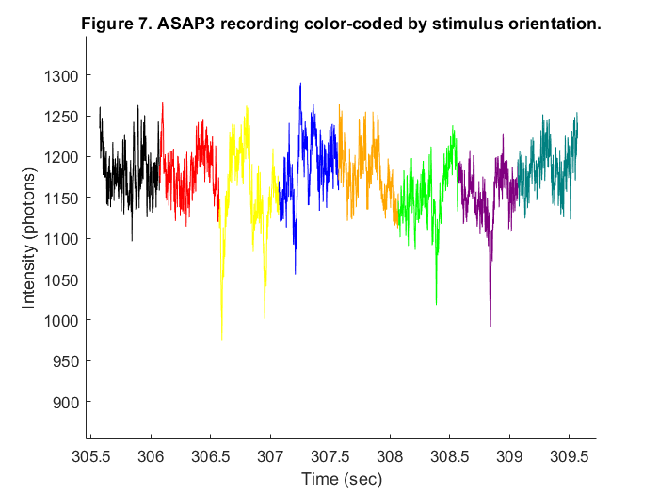
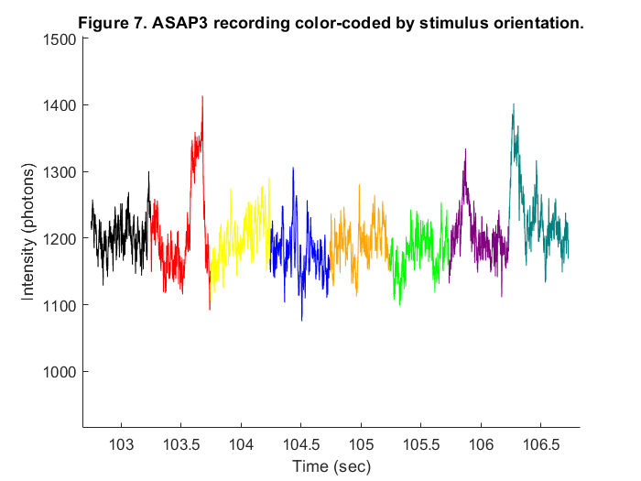
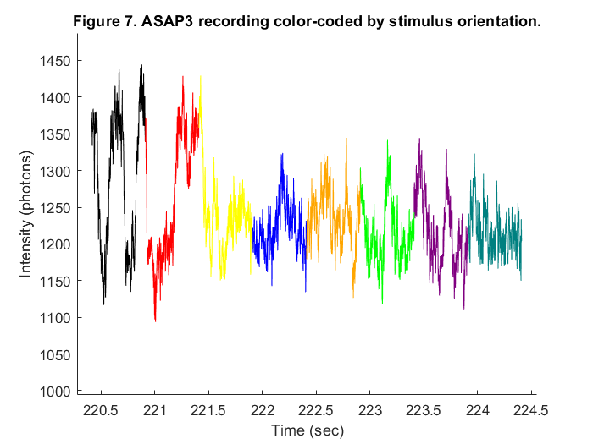
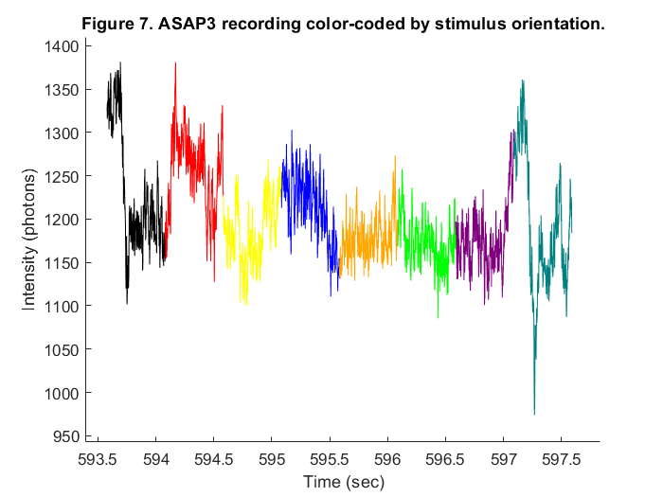

Slide 16
Caveats and other things to consider
OFF spiking, ~40% of spikes in ~30% of the time
Subthreshold activity, up/down states, hyperpolarizations not analyzed
Only analyzed one cell in L1
Initial responses to ON and OFF stimuli not analyzed
Direction selectivity with each ON period not analyzed
There is a wealth of data to look at!

Slide 17
Acknowledgements and thanks
ASAP voltage imaging
Benjamin Mathieu
Stéphane Dieudonné
Michael Lin
Check out the paper on biorxiv (Chavarha et al., 2019)
Flor Iacaruso
Calcium Imaging
Luca Godenzini
Clarissa Whitmire
All the instructors and TAs for the feedback and thorough answers to questions. Thor labs for providing calcium imaging 2p system.

