Slide 1
Widefield & 2P imaging of mouse primary sensory cortecies
Tuce Tombaz
CSHL Imaging 2019

Slide 2
Aim of the project
Determine the locations of strongest responses to visual and somatosensory stimuli using widefield imaging
Determine single cell responses to visual and non-visual (running) stimuli using 2P

Slide 3
Method
CamKIIα-GCaMP6s transgenic animal
Visual and somatosensory stimuli were programmed with Arduino
Widefield recording over the dorsal cortex
2P recording in V1 layer 2/3 neurons

Slide 4
Experimental setup
2P- bruker
0.8 NA
16X
Widefield microscope
2 SLR lenses (fl:105mm-50mm)
Arduino
To control the stimuli
Camera
Running wheel

Slide 5
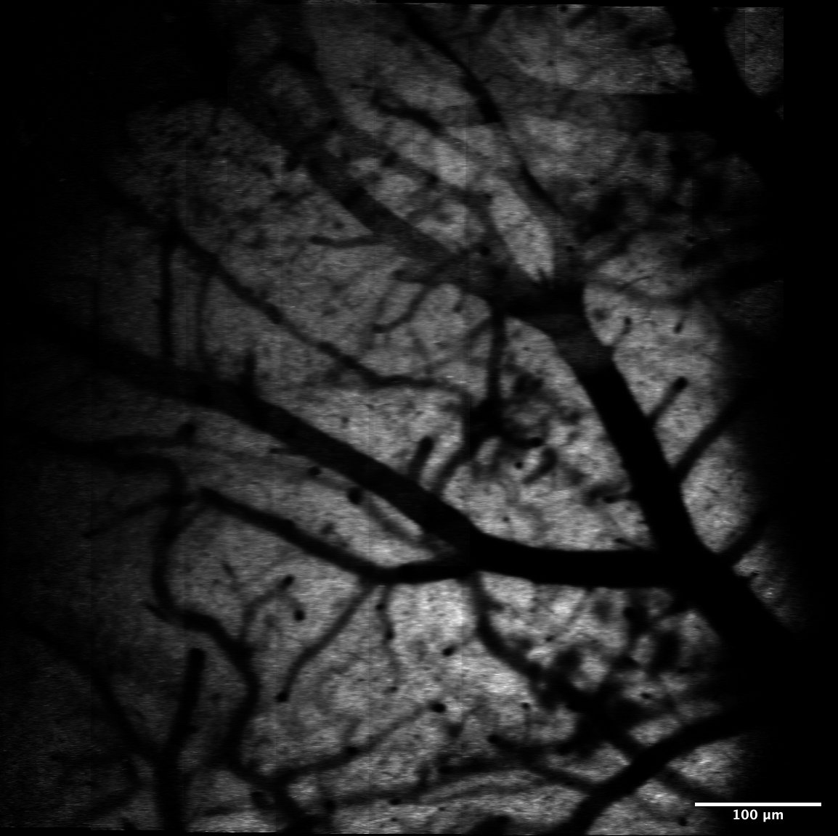
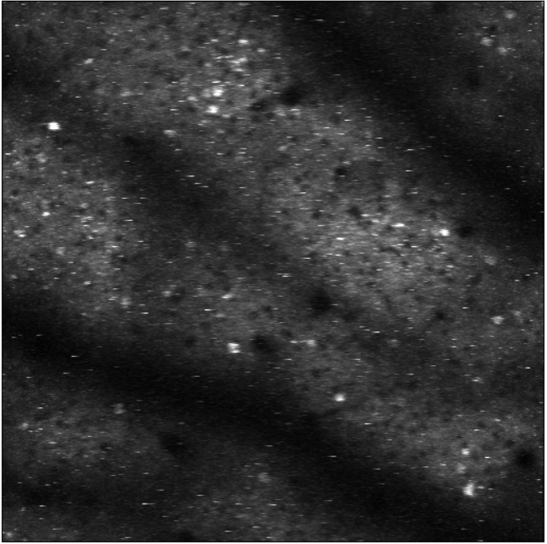
From widefield to 2P
1mm
100um
S1
M1
PPC
M
V1
2P – V1 L2/3
P
A
L
Widefield
2P single images stitched together

Slide 6
Mappings the cortical structures
Somatosensory trials
Visual trials
Average of 21 trials
Average of 22 trials
Baseline
Stimulus
Baseline
2s
5s
2s
10FPS

Slide 7
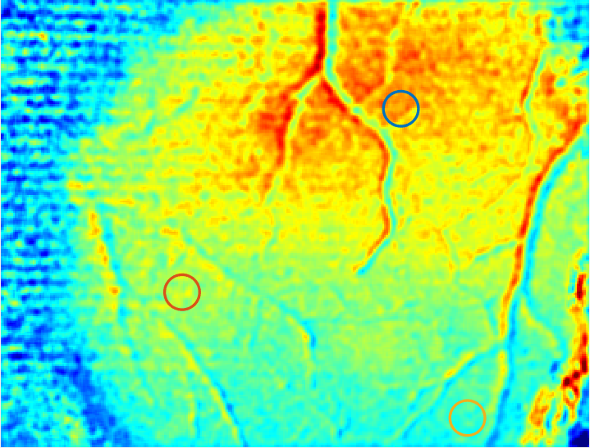
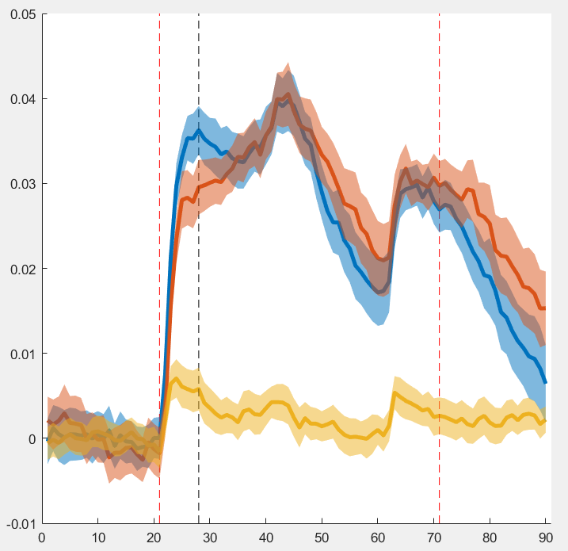
Brain wide activity during somatosensory stimuli
Stimulus ON
Df\f
Frame 28
Time (s)

Slide 8
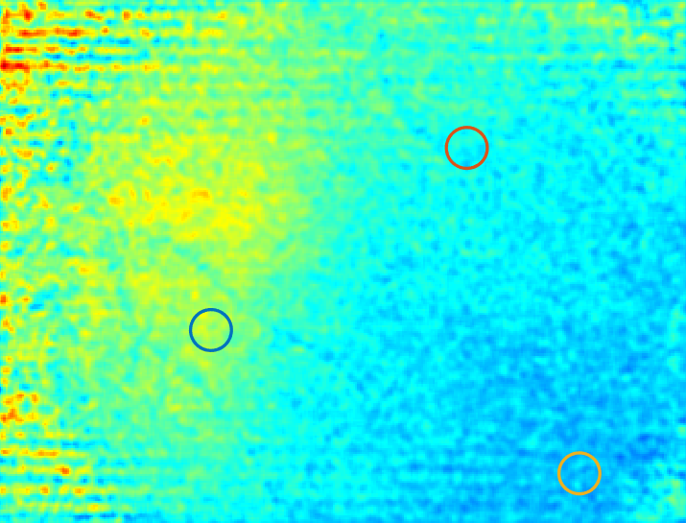
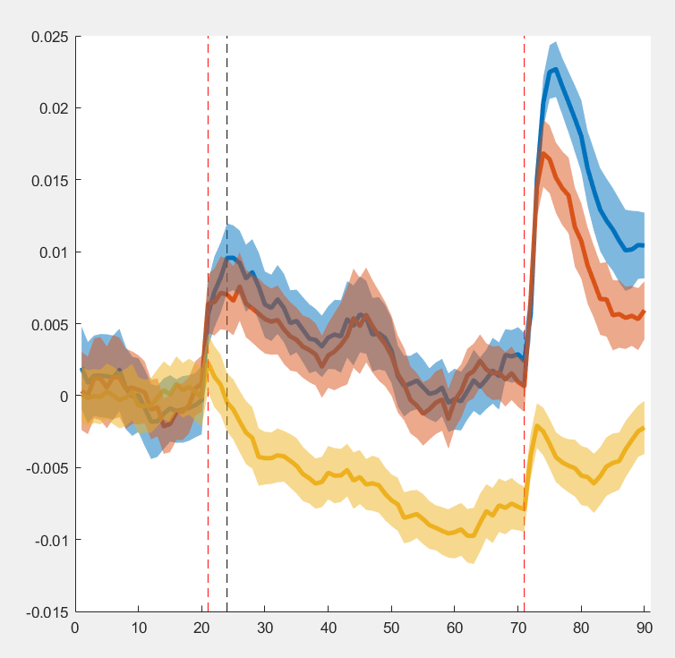
Brain wide activity during visual stimuli
Stimulus ON
Df\f
Frame 24
Time (s)

Slide 9
2P recordings in V1 L2/3 neurons
Spatial footprints
Field of view
6000fr recording
@30Hz
Suite2p
234 neurons
identified
2s-5Hz
8s
2s-5Hz

Slide 10
Raw video
Motion corrected
Motion artifact

Slide 11
Some of the responses of the identified neurons
Cells that responded to visual stimuli
Time (frames)
Blue: Neuropil corrected fluorescence trace
Black: Spike deconvolution

Slide 12
Cells that responded only some of the visual stimuli
Visual stimuli

Slide 13
Cells that responded animal’s motion
Running

Slide 14
Temporal profiles of all the neurons
234
# of cells
1
Visual stimuli
Running
1
Time (frame)
6000

Slide 15
Acknowledgements
TAs for the project
Arkarup Banerjee
Simon Musall
My group
Maya Kaelberer
Yunmiao Wang
Andrew Erskine
Thank you

