Slide 1
STAR+WASP Benchmarking
Lab meeting May 10th, 2022
Rebecca Asiimwe
Notes:
1

Slide 2
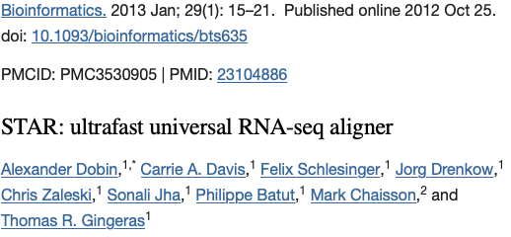
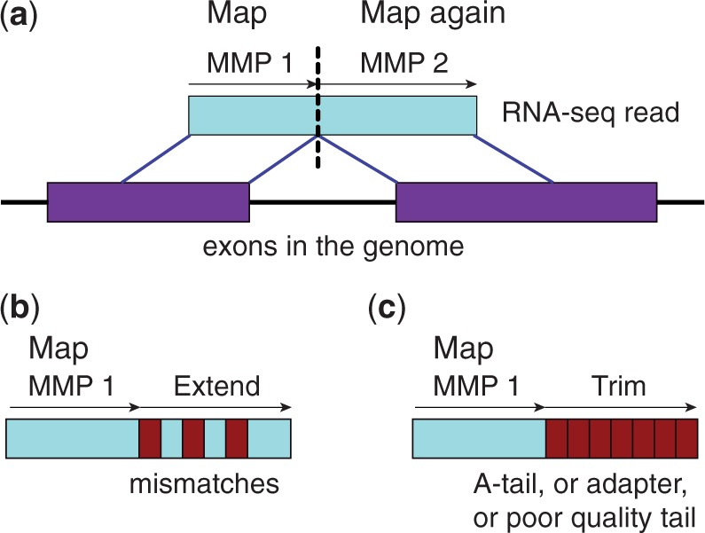
STAR: Spliced Transcripts Alignment to a Reference
Applies Sequential maximum mappable seed search in uncompressed suffix arrays → seed clustering and stitching procedure (Building alignments)
STAR achieves:
High mapping speeds
Accurately aligns both short and long reads (3rd gen)
Aligns large RNA-seq datasets
Improves alignment sensitivity and precision
Supports unbiased de novo detection of canonical splice junctions
Maps full-length RNA sequences
Dobin, et al. Bioinformatics (2013)
Notes:
2

Slide 3
Reference Bias
Preferential alignment of reads to the reference allele –
Reads with an alternative allele at a SNP less likely to map to the reference genome than reads carrying the reference allele
Read alignment performed using a linear reference genome (e.g GRCh38 assembly) as a template:
Work naturally with efficient text indexes and sequence alignment algorithms
-ve:
Does not capture the genomic diversity of a population
Difficulty in mapping reads that carry genomic variants
Reads that highly differ from the reference:
Do not map correctly
Mapped to the wrong position in the genome
Remain unmapped
Notes:
3

Slide 4
Consequences of Reference Bias
Errors in variant calls
Inaccurate genomic analysis and confounding of results downstream
Poor characterization of regions of high sequence or structural diversity (HLA genes)
Deficiency in characterizing transcripts carrying alternate alleles instead of the reference
Allelic ratio biases
Etc.
Notes:
4

Slide 5
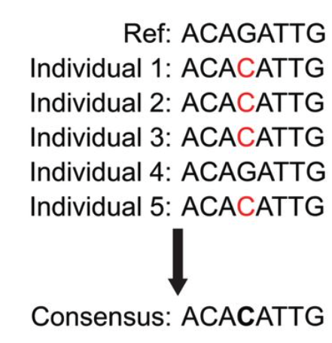
Alleviating Reference Bias
Improve the reference genome to capture genomic diversity
Construction of consensus genome - minor allele in reference is replaced by the most common/major allele in the population (Dobin et al)
Replace linear reference with structures like graphs that can include genetic variation
Use personalized genomes
WASP
Dobin et al, Genome Res (2022)
Notes:
5

Slide 6
Unbiased Read Mapping with WASP
Suite of tools:
Correct for biases in allele-specific mapping
Discovery of molecular QTLs
Approach can be readily incorporated into any read-mapping pipeline.
Obtains low false positive rates
The process of generating reads with alternative genotypes in WASP takes a relatively long time
Many reads are excluded due to WASP’s stringent requirements
Mappability filtering pipeline for correcting allelic mapping biases. van de Geijn , et al. Nature (2015)
Notes:
6

Slide 7
AIM:
STAR+WASP

Slide 8
Speed and Memory Benchmarks
Server specifications (Atlas):
2 32-core CPUs
AMD Ryzen Threadripper PRO 3975WX CPU
3.5GHz
528 GB memory (RAM)
Notes:
8

Slide 9
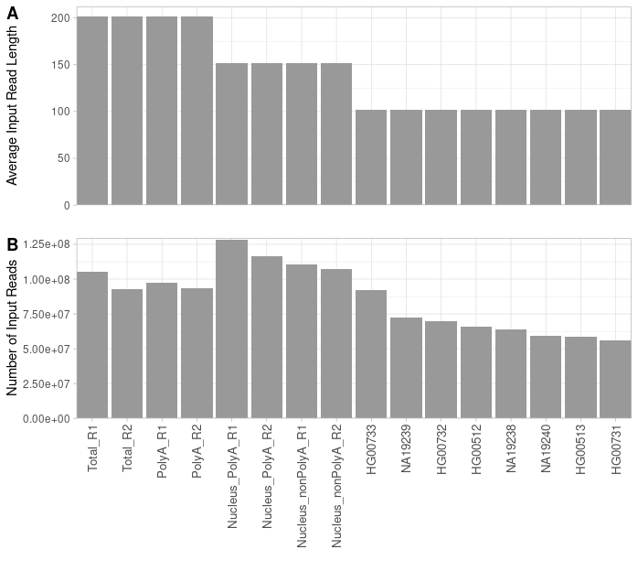
Samples Run (n=16)
- 1000 Genomes Project
- 8, 16, 32 threads per sample run
STAR (STAR-2.7.10a)
STAR+WASP
WASP
- Run with full capacity of server
- Input reads (paired-end):
Min = ~5.6 Million reads
Mean = ~87 Million reads
Max = ~128 Million reads

Slide 10
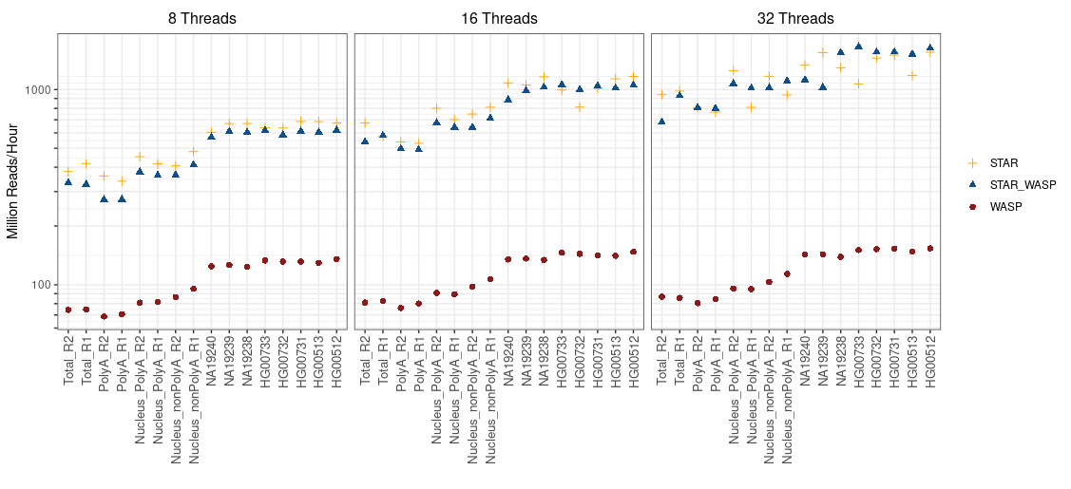
Benchmarks: Speed - Wall Time
Notes:
10

Slide 11
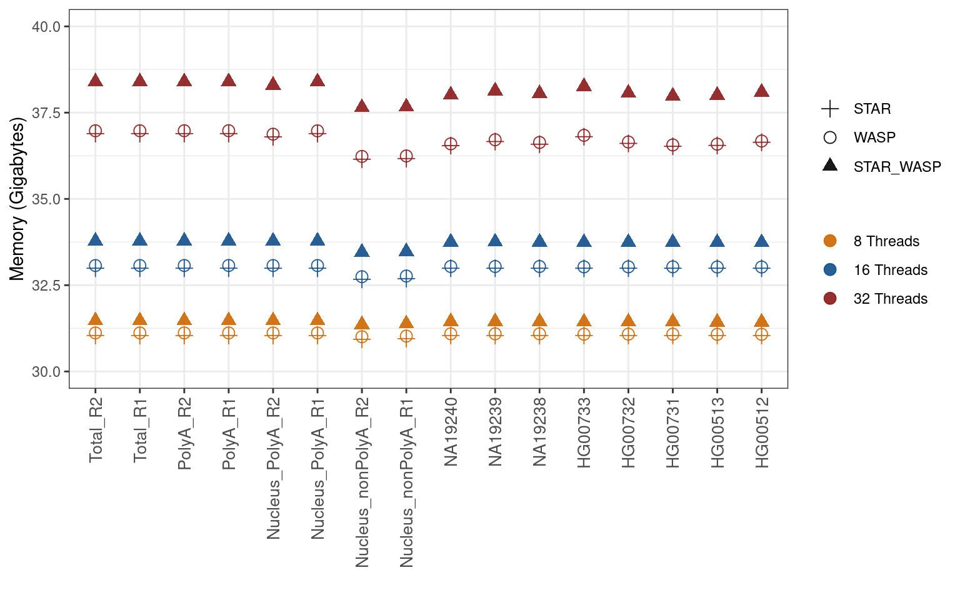
Benchmarks: RAM Usage

Slide 12
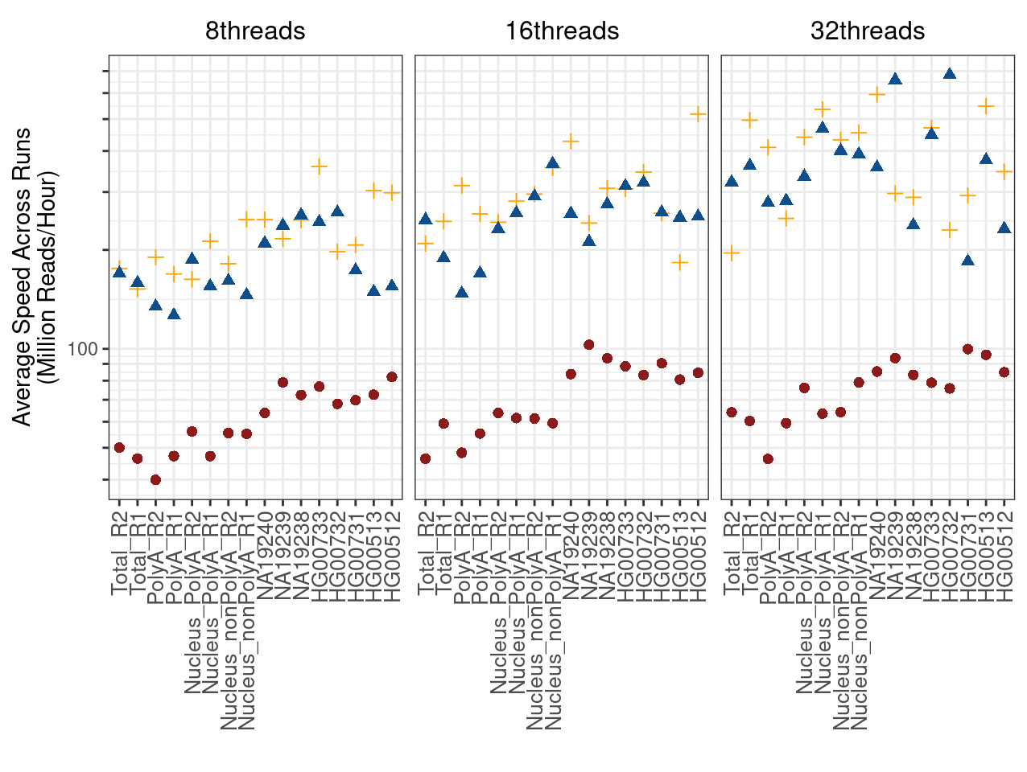
Benchmarks: Speed - Wall Time (Elzar Runs)
Atlas
Elzar

Slide 13
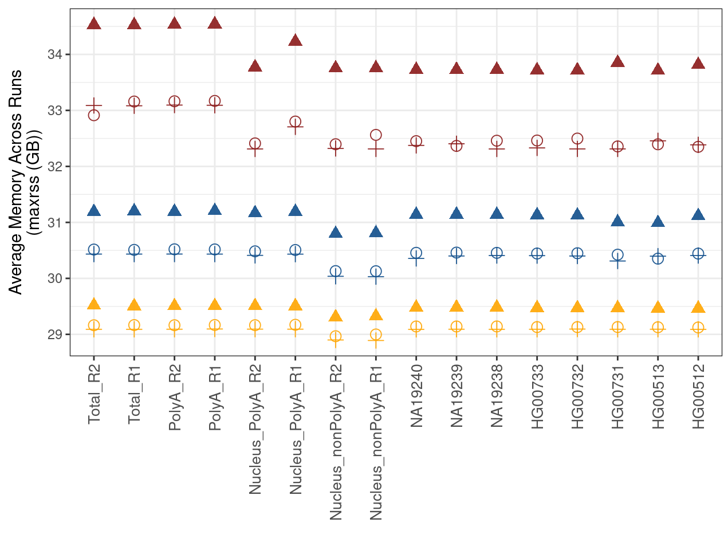
Benchmarks: RAM Usage (Elzar Runs)
Atlas
Elzar

Slide 14
WASP Filtering (STAR+WASP)
Re-implementation of WASP algorithm in STAR
WASP filtering activated by --waspOutputMode SAMtag (adds a vW tag to the SAM output)
vW:i:1 means alignment passed WASP filtering
All other values mean it did not pass:
vW:i:2 - multi-mapping read
vW:i:3 - variant base in the read is N (non-ACGT)
vW:i:4 - remapped read did not map
vW:i:5 - remapped read multi-maps
vW:i:6 - remapped read maps to a different locus
vW:i:7 - read overlaps too many variants

Slide 15
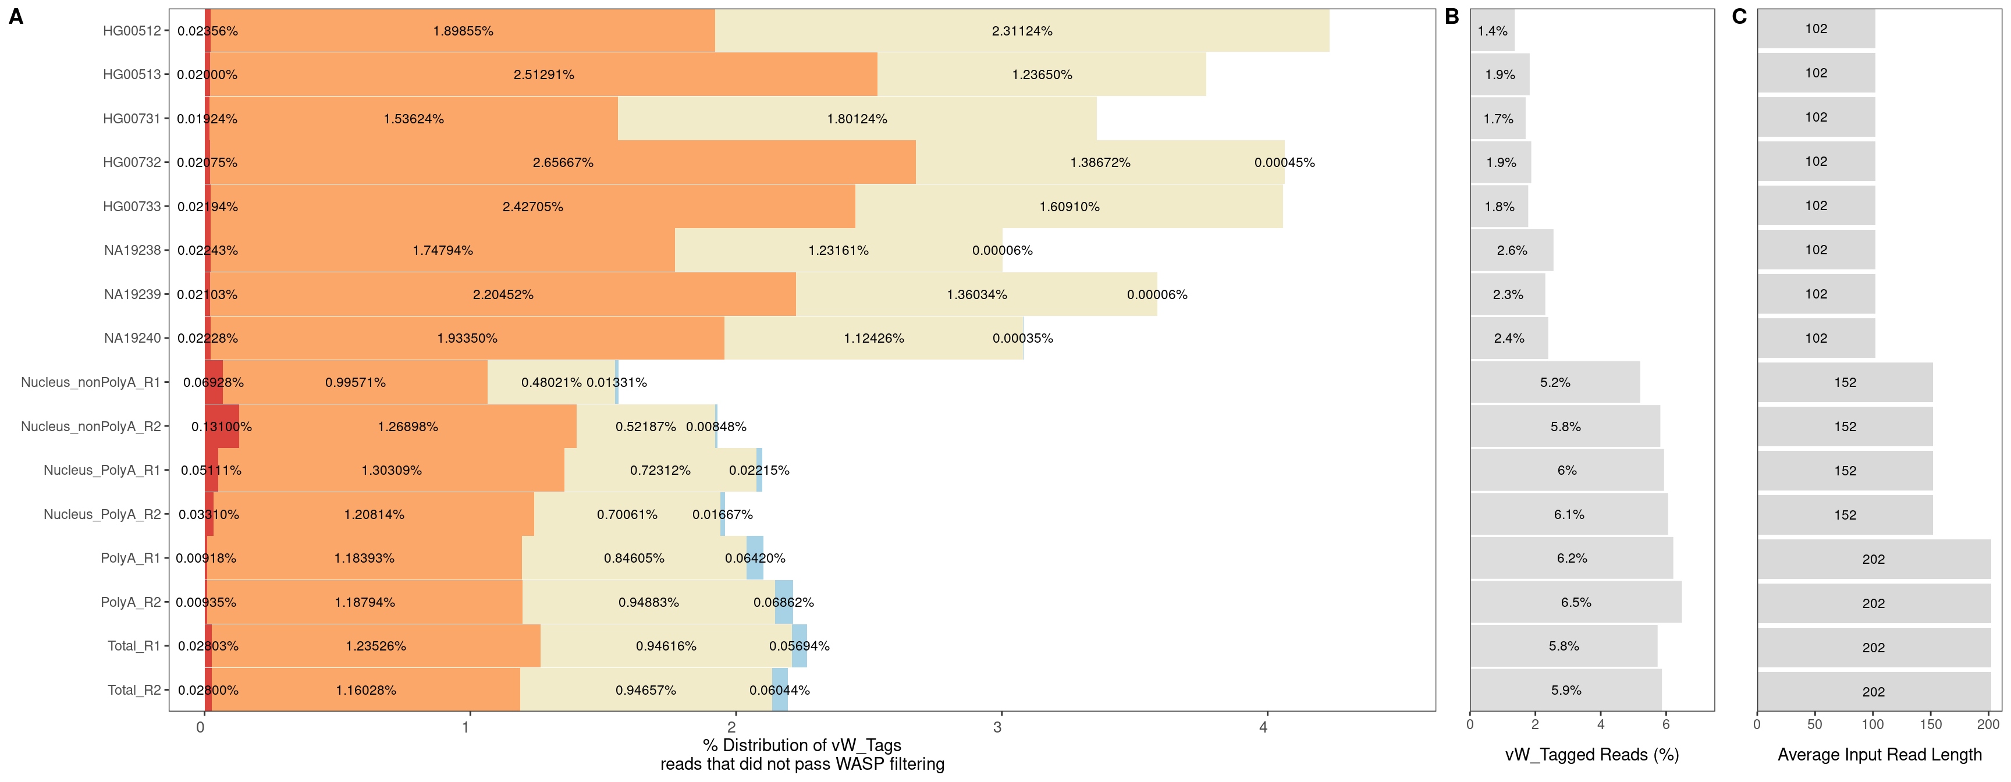
vW_Tag distributions for alignments that did not pass WASP filtering

Slide 16
Reference Bias
Notes:
HET sites
Removed inconsistent haplotypes
16

Slide 17
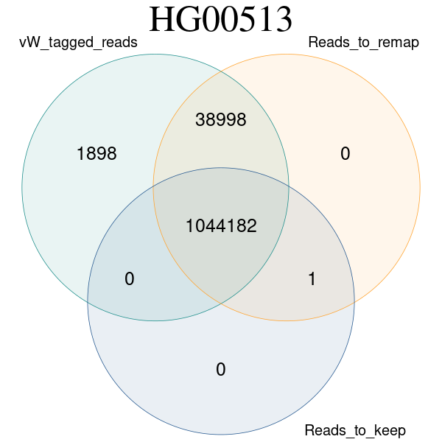
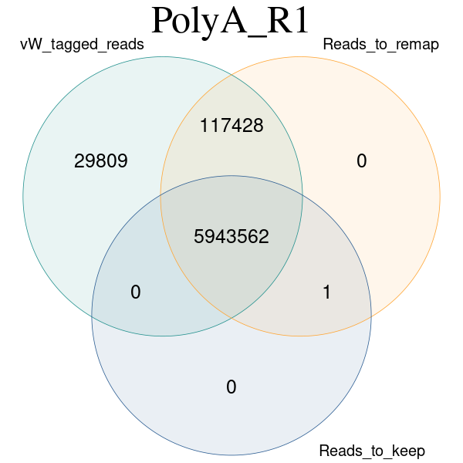
Moving Forward
Dissecting reads from WASP filtering
Figure and Data prep
Write manuscript

Slide 18
Thank You!

Slide 20
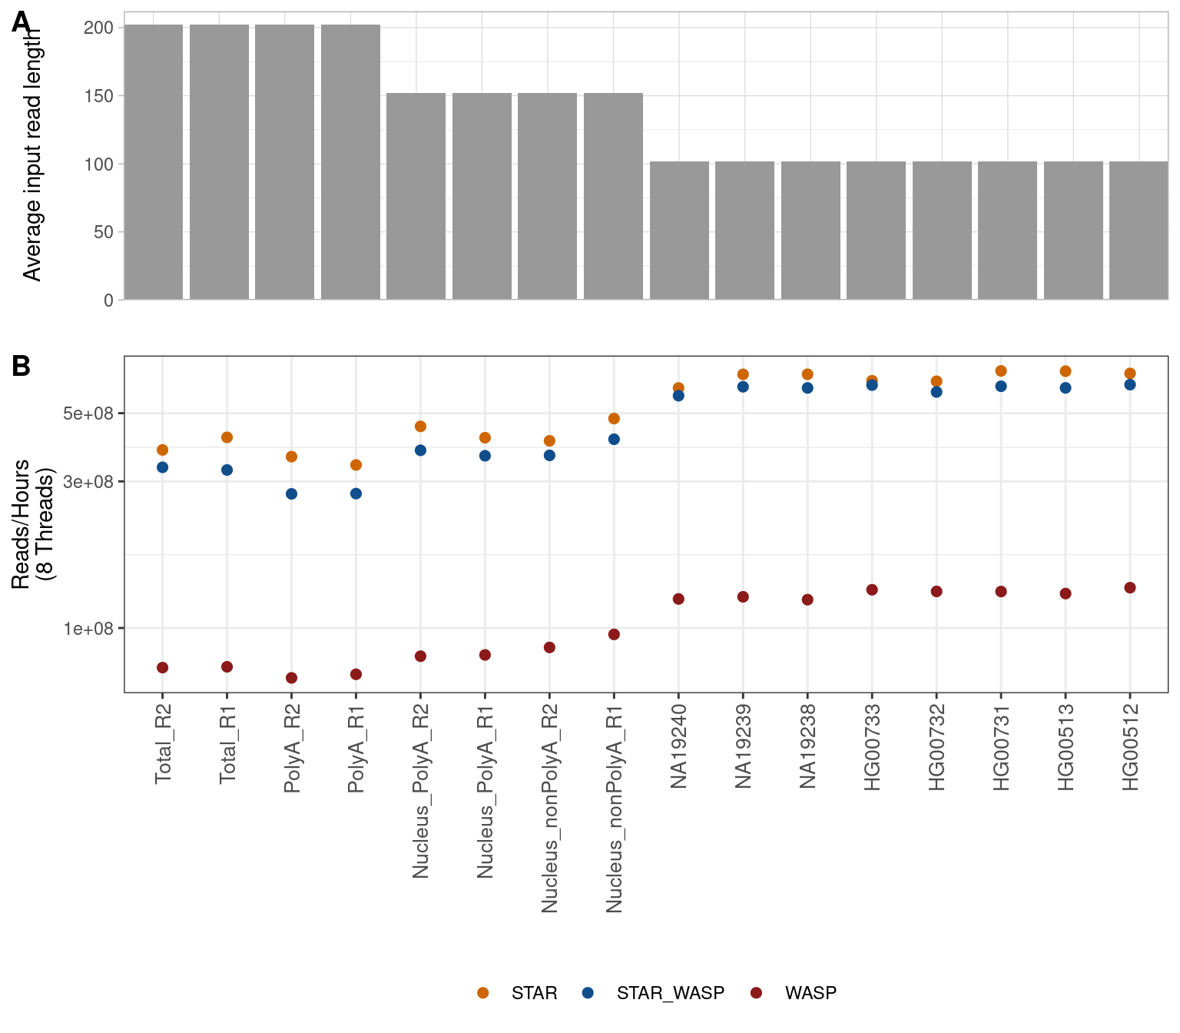
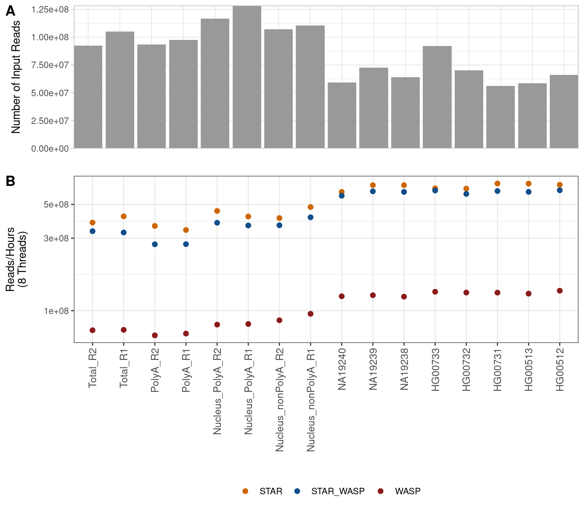
Speed Vs Average Input Read Length and Number of Input Reads Respectively

Slide 22
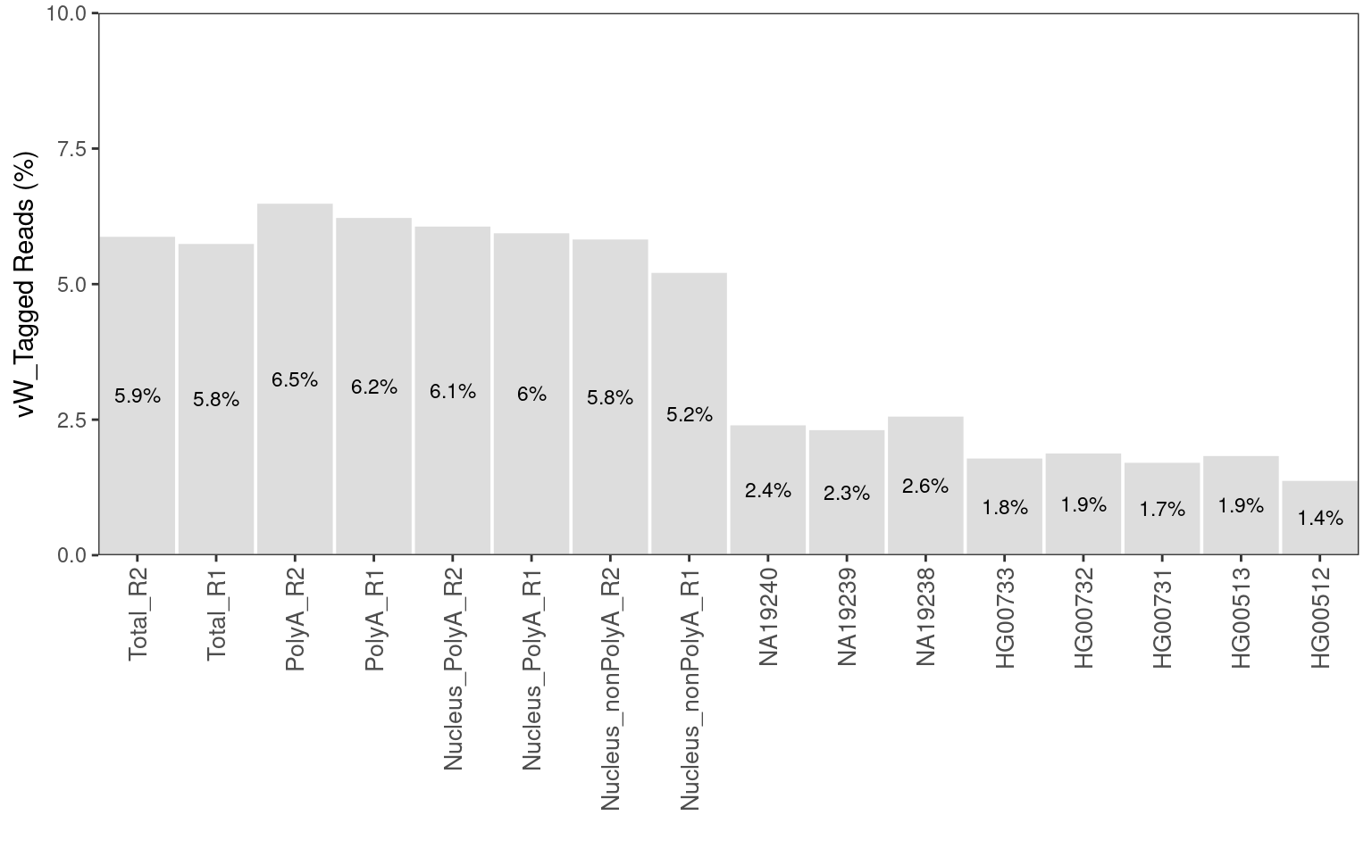
Reads that overlapped variants and failed WASP filtering

Slide 23
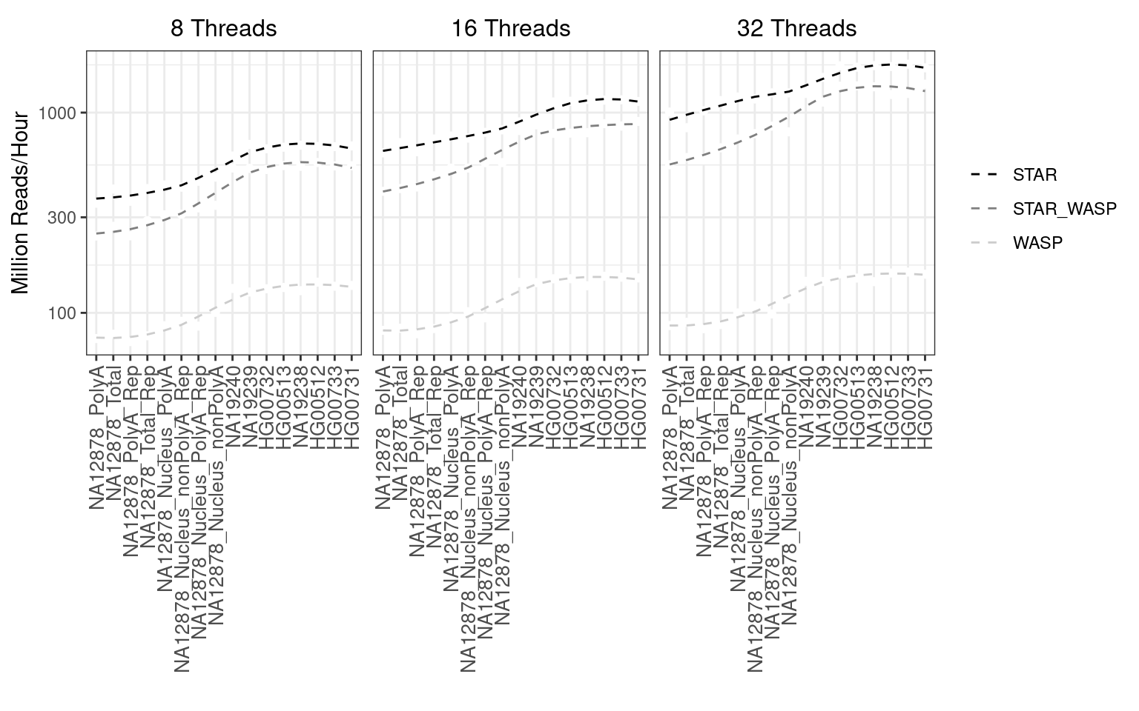
Notes:
23

Slide 24
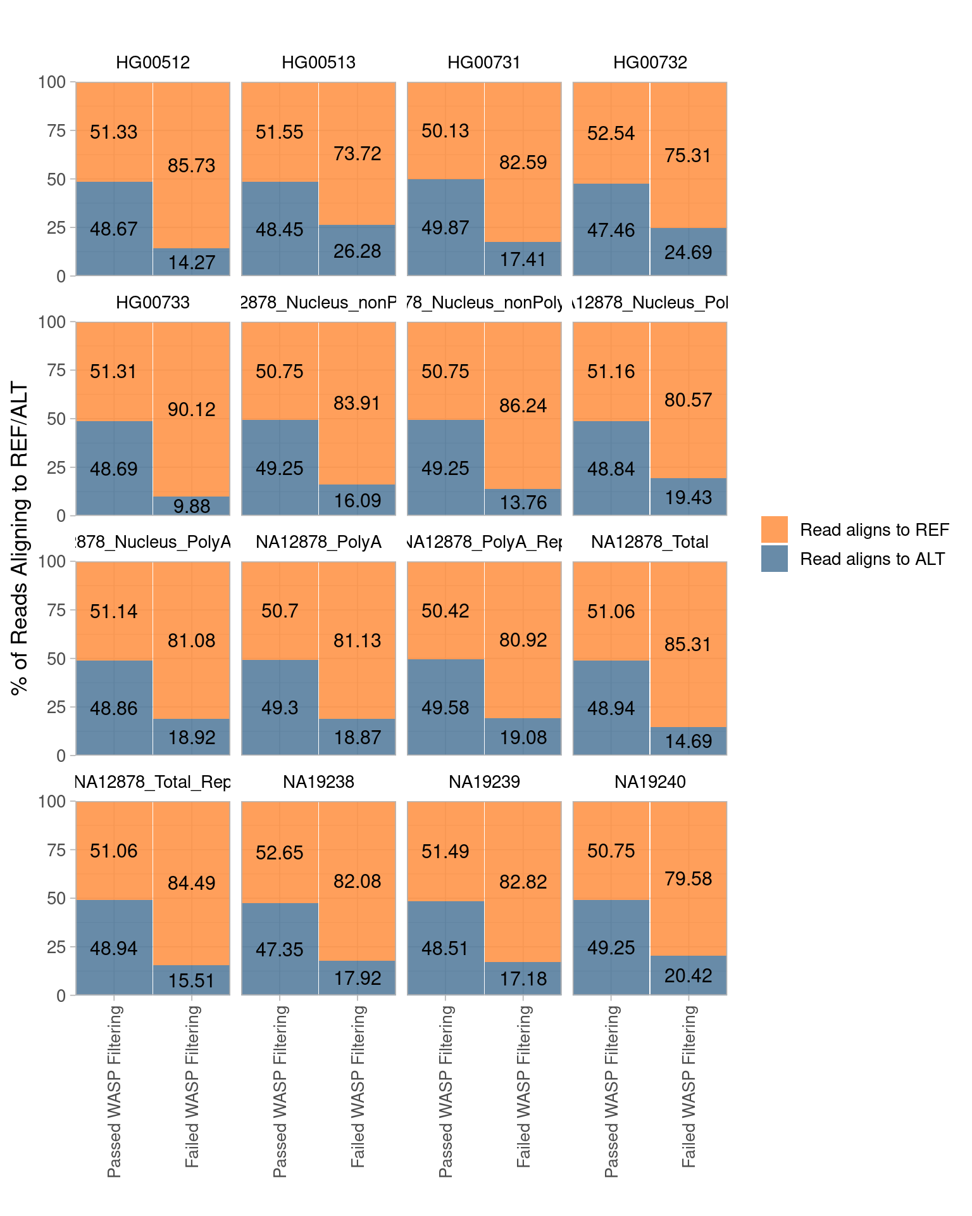
Heterozygous SNPS
Removed inconsistent haplotypes
Notes:
24

Slide 25
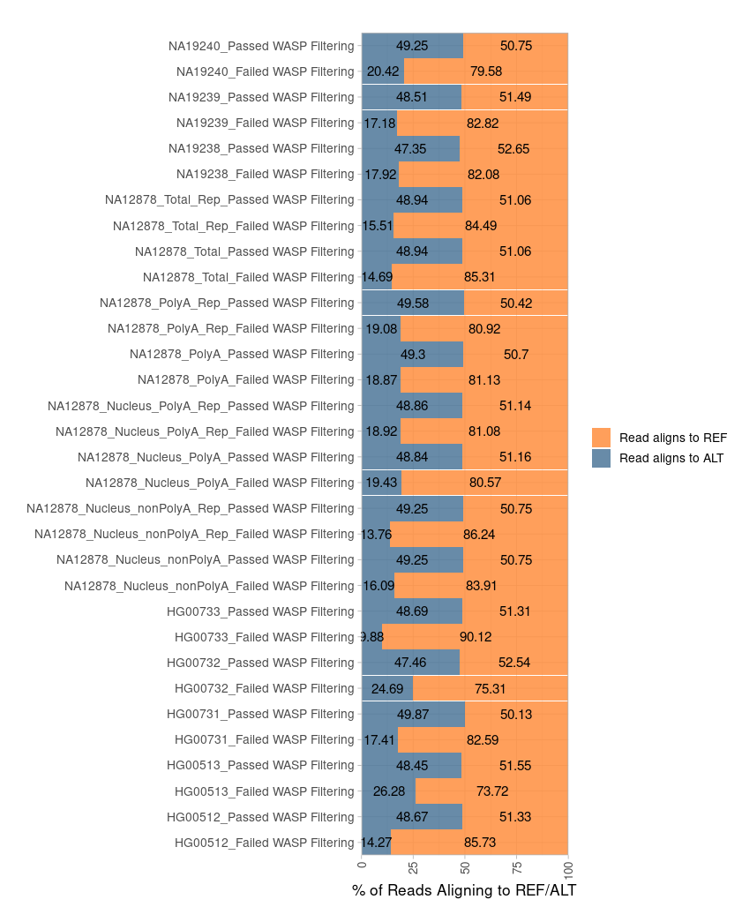
Notes:
25

Slide 26
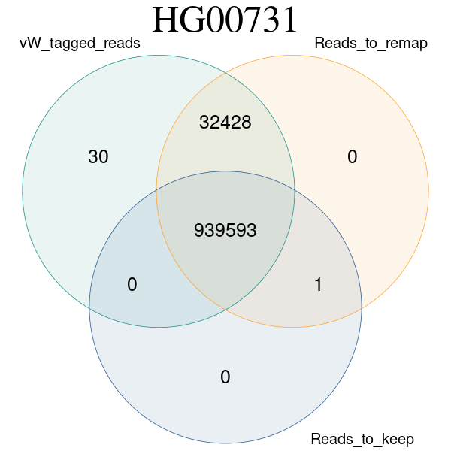
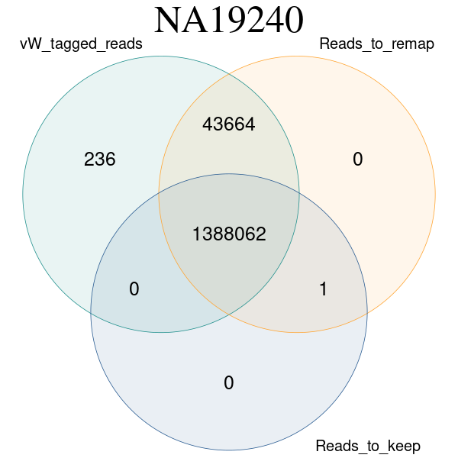
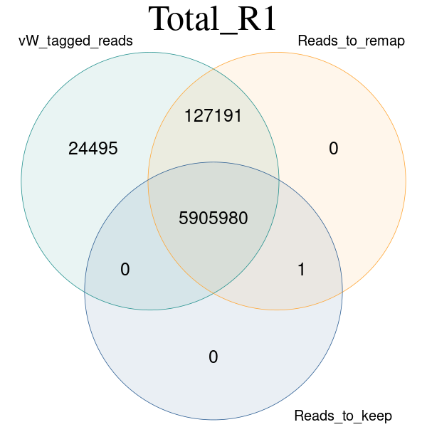
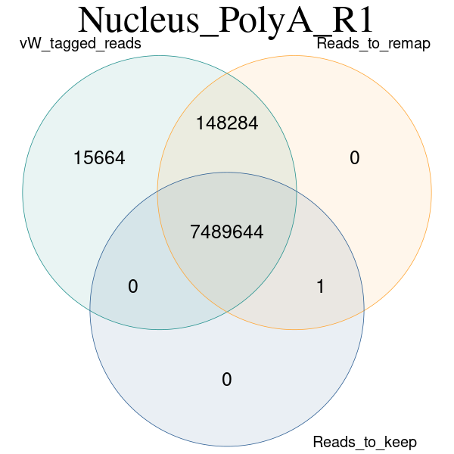

Slide 27
Notes:
27

